Slide 1
Machine Efficiency
Dec. 7, 2015

Slide 2
Learning Targets
You will be able to calculate the efficiency of a Machine
You will be able to determine whether a machine gives a good work output compared to the work input.

Slide 3
Agenda and Reminders
Kinetic/Potential Energy Quiz
Go over parts 9-10 of Homework Packet II
Efficiency Calculations
Homework: Finish review packet and part 7 in hw. Pkt. 3
REMINDERS
University of Texas due tonight and a new one opens today
Test on Wednesday

Slide 4
Quiz Formulas
PE=mgh
KE=1/2 mv²
E_{total}=E_{kinetic} + E_{potential}

Slide 5
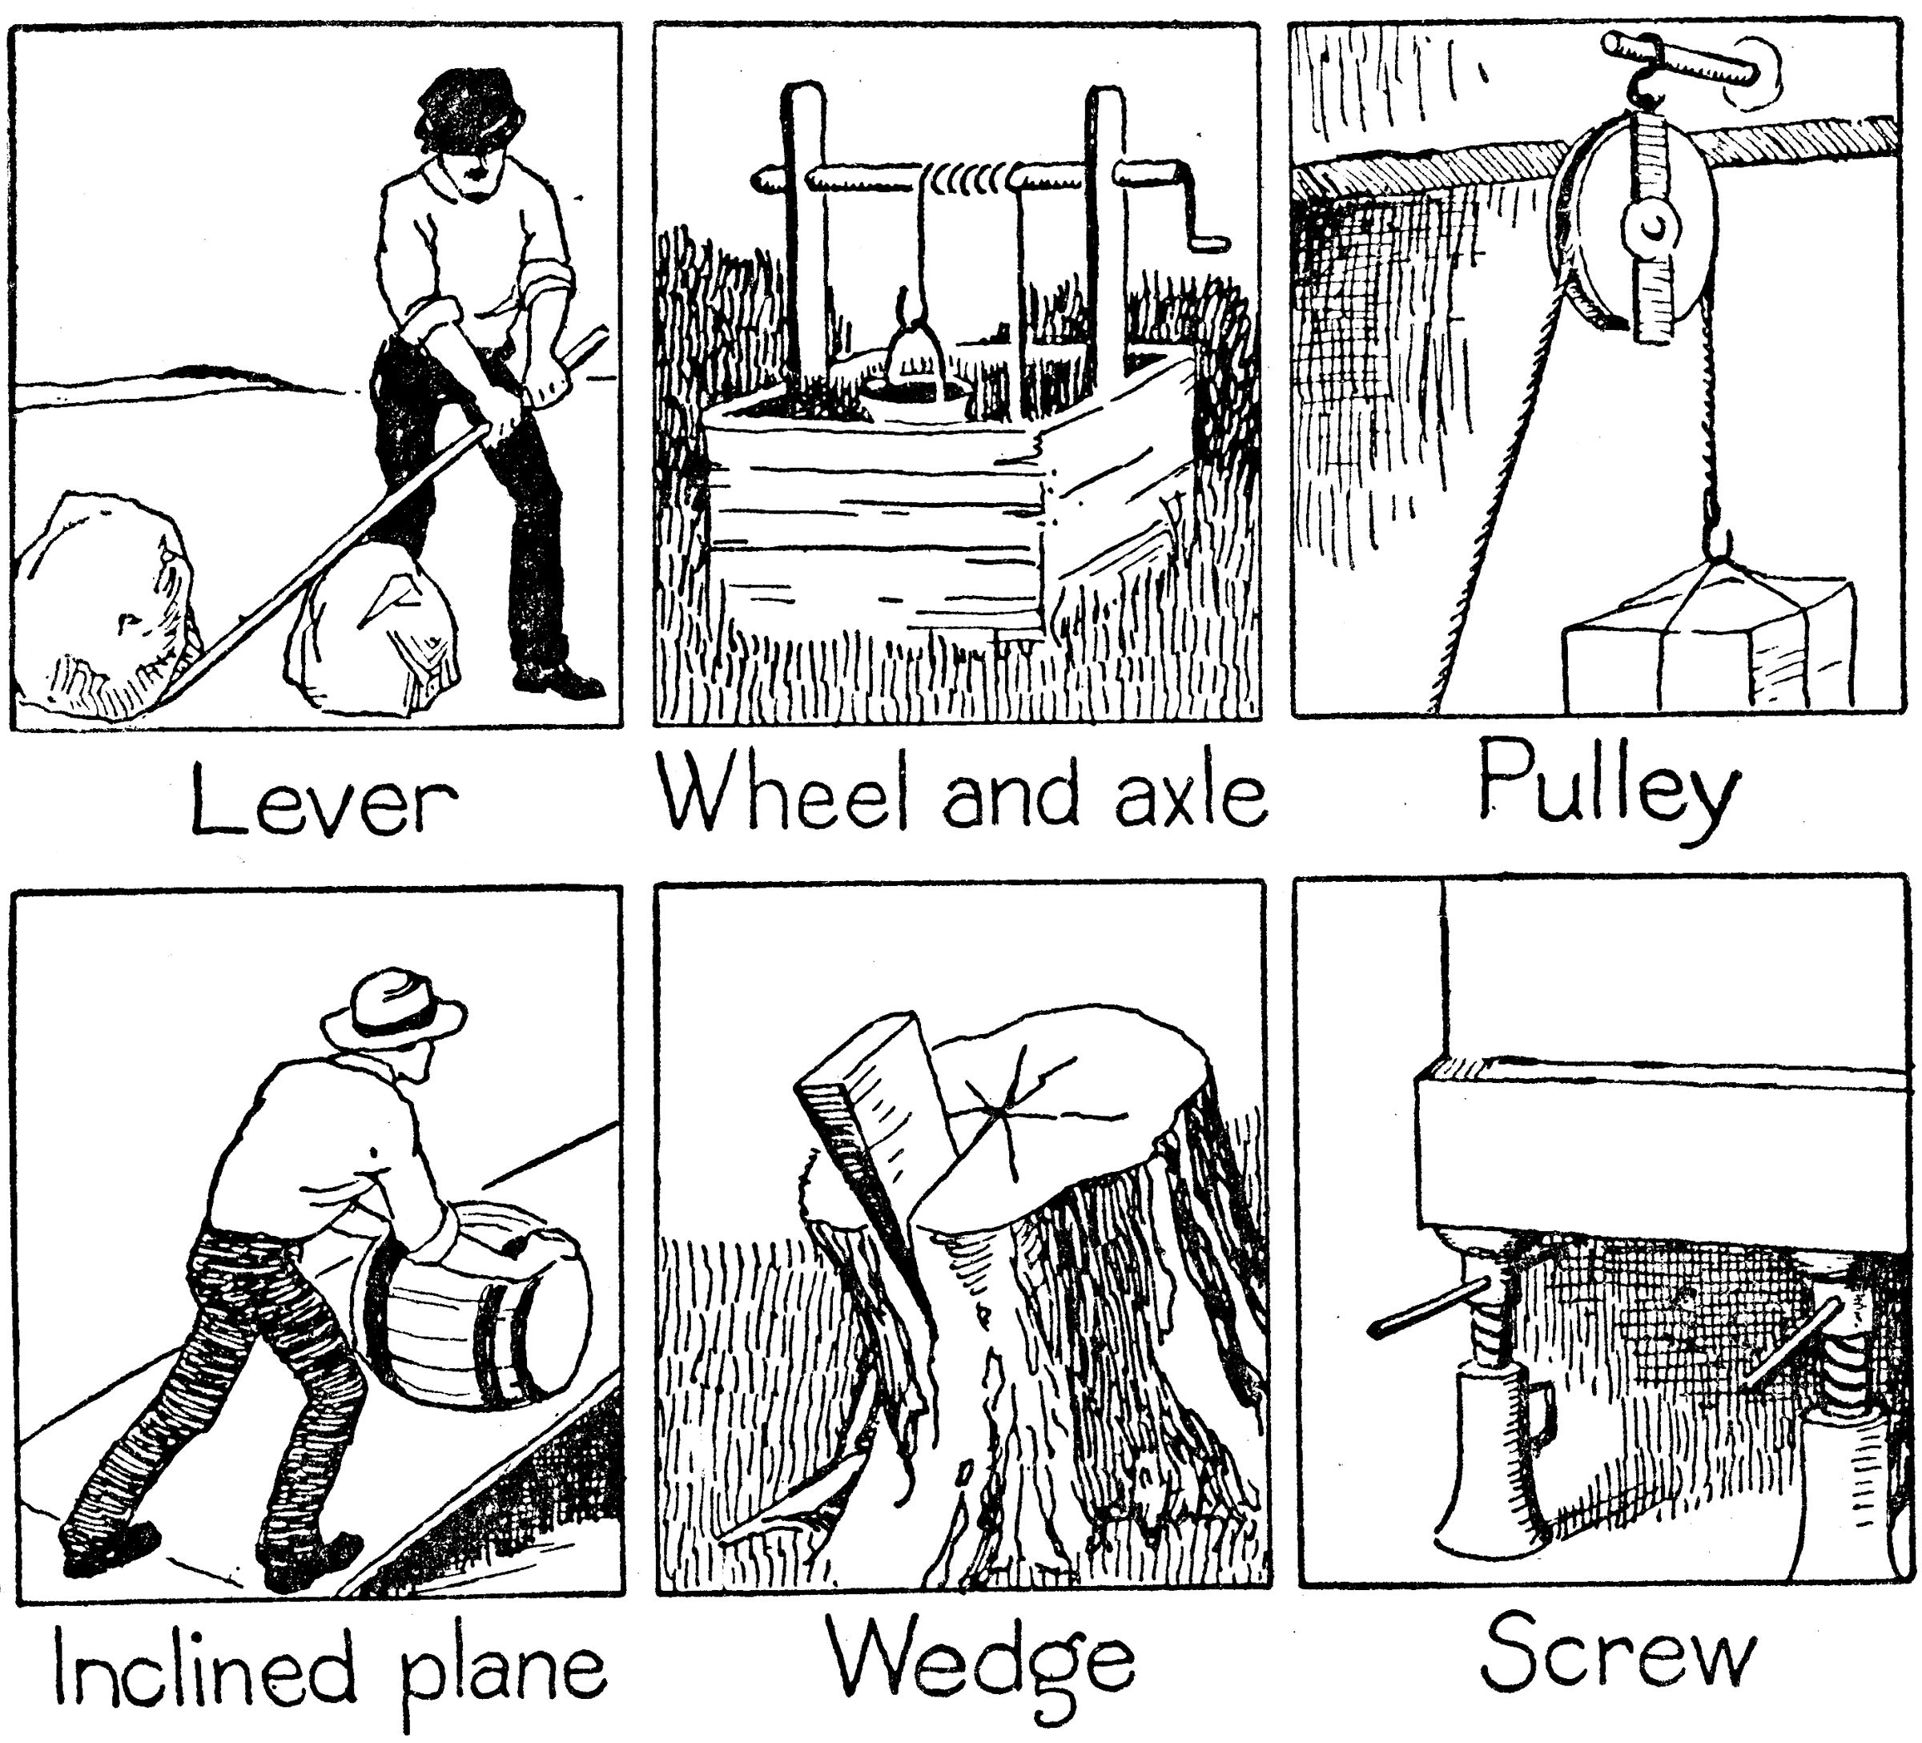
Efficiency
Work Output
the work done by a simple machine, compound machine, or any type of engine model
Work Input
work done on a machine equal to the effort force times the distance through which the force is applied
Efficiency
the ratio of the useful work performed by a machine or in a process to the total energy expended or heat taken in.

Slide 6
Efficiency Formula

Slide 7
You do 20J of work while using a hammer. The hammer does 18J of work on a nail. What is the efficiency of the hammer?

Slide 8
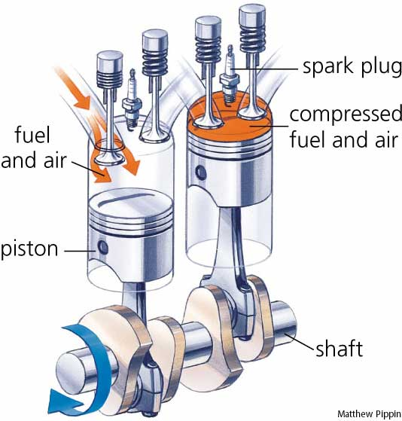
An automobile gasoline engine is able to do 225 J of useful work with each stroke of its pistons. If the engine has an efficiency of 29.0 percent, what is the amount of work that must be done on the pistons in the engine?

Slide 9
A certain solar panel is capable of absorbing 750J of light energy every second, and converting 150J of that energy into electrical energy.
How much energy is ‘wasted’ in the form of heat by the solar panel every second?
What is the efficiency of this solar panel?

Slide 10
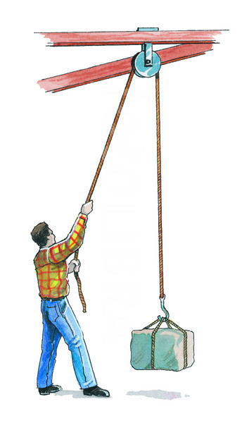
A pulley system operates with 40% efficiency. If the work put in is 200 J, how much useful work is produced?

Slide 11
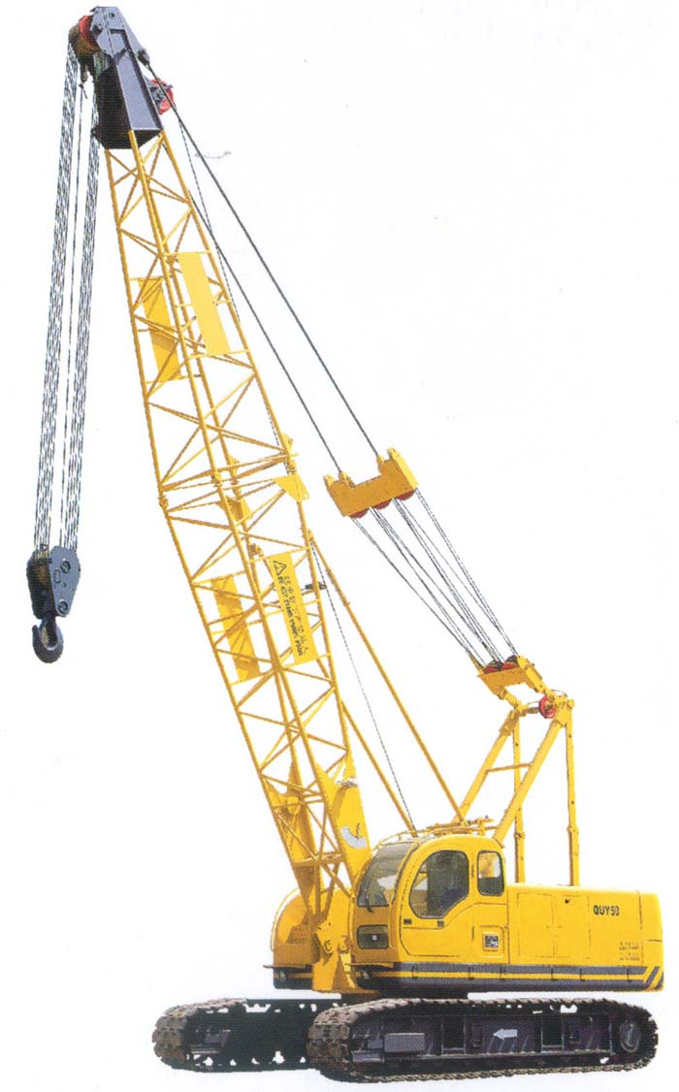
A crane moved a 200 kg hot tub from the ground to the top of the hotel, 53 m above the ground. If the crane used 200,000 J of energy, how efficient was the crane?

